Slide 1


Machine Learning,
Decision Trees

Slide 2
Function approximation
Setting:
Set of possible instances X
Unknown target function f: X→Y
Set of function hypotheses H={ h | h: X→Y }
Given:
Training examples {<x_{i},y_{i}>} of unknown target function f
Determine:
Hypothesis h∈ H that best approximates f

Slide 3
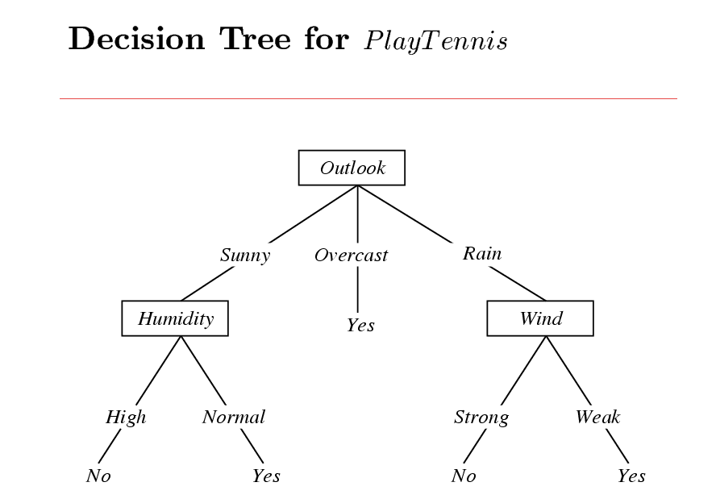
Each node: test one attribute X_{i}
Each branch from a node: selects one value for X_{i}
Each leaf node: predict Y

Slide 4
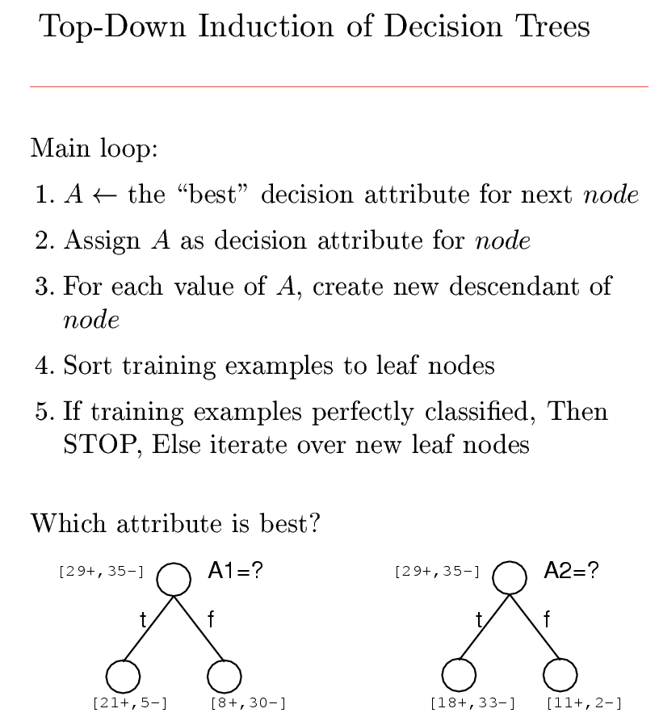
node = Root

Slide 5

Entropy
Entropy is the measure of randomness of sample data, depending on the number of possible values and the total size of the set.
Quantifies “randomness”
Lower value of entropy implies less uncertainty
Higher value of entropy implies more uncertainty

Slide 6
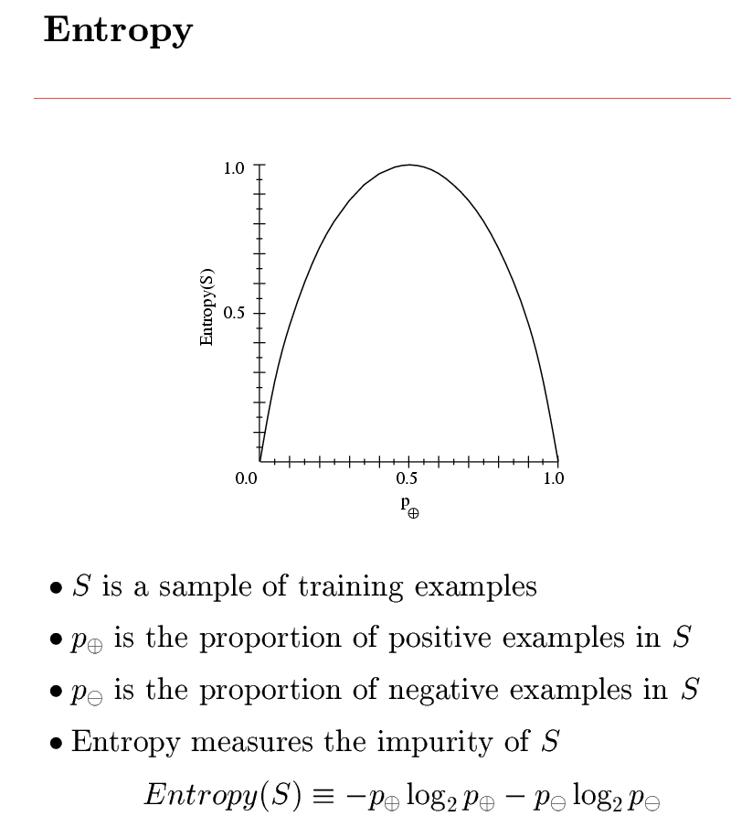

Sample Entropy

Slide 7
Information Gain
Information Gain calculates effective change in entropy after making a decision based on the value of an attribute.
For decision trees, it’s ideal to base decisions on the attribute that provides the largest change in entropy, the attribute with the highest information gain.

Slide 8
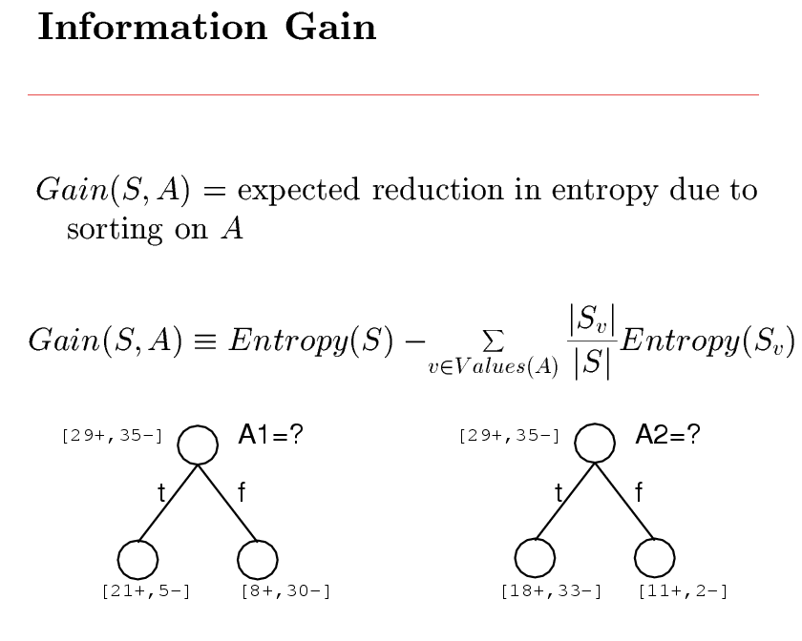
Subset of S for which A=v

Slide 9
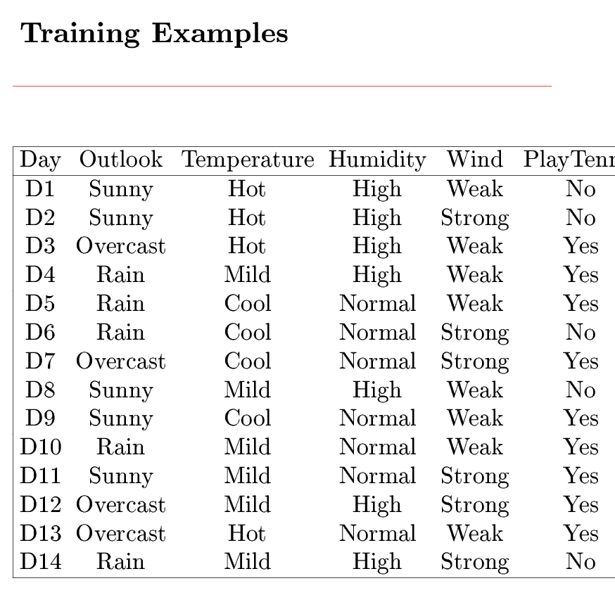

Slide 10
Decision Tree Learning
Let’s Try an Example!
Let
  E([X+,Y-]) represent that there are X positive training elements and Y negative elements.
Therefore the Entropy for the training data, E(S), can be represented as E([9+,5-]) because of the 14 training examples 9 of them are yes and 5 of them are no.

Slide 11
Decision Tree Learning
Let’s start off by calculating the Entropy of the Training Set.
E(S) = E([9+,5-]) = (-9/14 log₂ 9/14) + (-5/14 log₂ 5/14) = 0.94

Slide 12
Decision Tree Learning
Next we will need to calculate the information gain G(S,A) for each attribute A where A is taken from the set
{Outlook, Temperature, Humidity, Wind}.

Slide 13
Decision Tree Learning
The information gain for Outlook is:
  G(S,Outlook) = E(S) – [5/14 * E(Outlook=sunny) + 4/14 * E(Outlook = overcast) + 5/14 * E(Outlook=rain)]
  G(S,Outlook) = E([9+,5-]) – [5/14*E(2+,3-) + 4/14*E([4+,0-]) + 5/14*E([3+,2-])]
  G(S,Outlook) = 0.94 – [5/14*0.971 + 4/14*0.0 + 5/14*0.971]
  G(S,Outlook) = 0.246

Slide 14
Decision Tree Learning
The information gain for Temperature is:
G(S,Temperature) = 0.94 – [4/14*E(Temperature=hot) + 6/14*E(Temperature=mild) + 4/14*E(Temperature=cool)]
G(S,Temperature) = 0.94 – [4/14*E([2+,2-]) + 6/14*E([4+,2-]) + 4/14*E([3+,1-])]
G(S,Temperature) = 0.94 – [4/14 + 6/14*0.918 + 4/14*0.811]
G(S,Temperature) = 0.029

Slide 15
Decision Tree Learning
The information gain for Humidity is:
G(S,Humidity) = 0.94 – [7/14*E(Humidity=high) + 7/14*E(Humidity=normal)]
G(S,Humidity = 0.94 – [7/14*E([3+,4-]) + 7/14*E([6+,1-])]
G(S,Humidity = 0.94 – [7/14*0.985 + 7/14*0.592]
G(S,Humidity) = 0.1515

Slide 16
Decision Tree Learning
The information gain for Wind is:
G(S,Wind) = 0.94 – [8/14*0.811 + 6/14*1.00]
G(S,Wind) = 0.048

Slide 17
Decision Tree Learning
Which attribute should be tested at the root?
  Gain(S, Outlook) = 0.246
  Gain(S, Humidity) = 0.151
  Gain(S, Wind) = 0.084
  Gain(S, Temperature) = 0.029
Outlook provides the best prediction for the target
Lets grow the tree:
  add to the tree a successor for each possible value of Outlook
  partition the training samples according to the value of Outlook

Slide 18
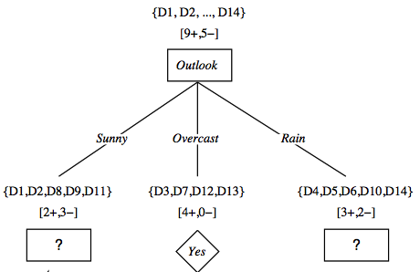
Decision Tree Learning

Slide 19
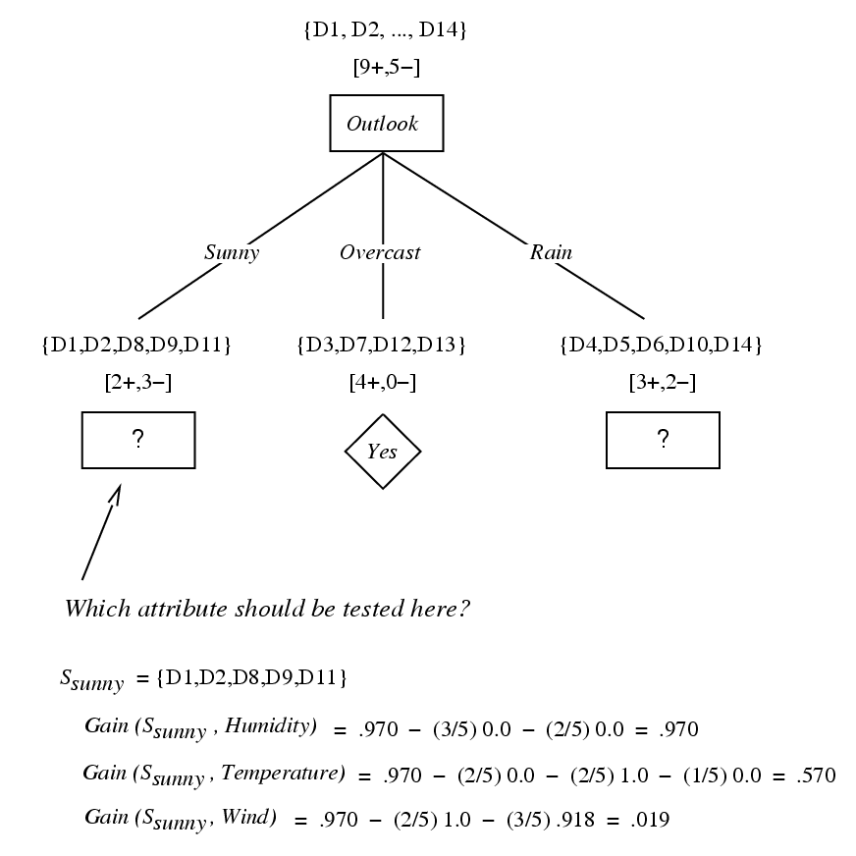

Slide 20
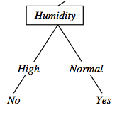
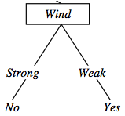
{D1, D2, D8}
No
{D9, D11}
Yes
{D4, D5, D10}
Yes
{D6, D14}
No

Slide 21
Example: The Simpsons

Slide 22










Person | Hair Length | Weight | Age | Class
Homer | 0” | 250 | 36 | M
Marge | 10” | 150 | 34 | F
Bart | 2” | 90 | 10 | M
Lisa | 6” | 78 | 8 | F
Maggie | 4” | 20 | 1 | F
Abe | 1” | 170 | 70 | M
Selma | 8” | 160 | 41 | F
Otto | 10” | 180 | 38 | M
Krusty | 6” | 200 | 45 | M
Comic | 8” | 290 | 38 | ?

Slide 23
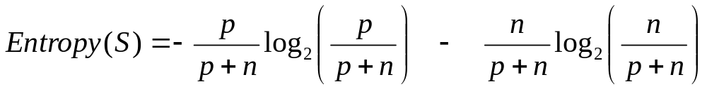
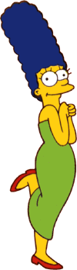


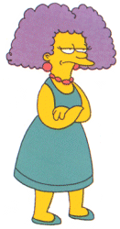
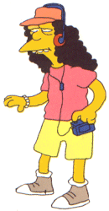
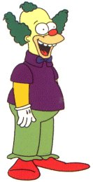
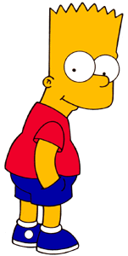

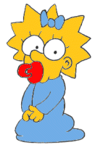
Entropy(4F,5M) = -(4/9)log₂(4/9) - (5/9)log₂(5/9)
= 0.9911
yes
no
Hair Length <= 5?
Let us try splitting on Hair length
Entropy(1F,3M) = -(1/4)log₂(1/4) - (3/4)log₂(3/4)
= 0.8113
Entropy(3F,2M) = -(3/5)log₂(3/5) - (2/5)log₂(2/5)
= 0.9710
Gain(Hair Length <= 5) = 0.9911 – (4/9 * 0.8113 + 5/9 * 0.9710 ) = 0.0911

Slide 24
Entropy(4F,5M) = -(4/9)log₂(4/9) - (5/9)log₂(5/9)
= 0.9911
yes
no
Weight <= 160?
Let us try splitting on Weight
Entropy(4F,1M) = -(4/5)log₂(4/5) - (1/5)log₂(1/5)
= 0.7219
Entropy(0F,4M) = -(0/4)log₂(0/4) - (4/4)log₂(4/4)
= 0
Gain(Weight <= 160) = 0.9911 – (5/9 * 0.7219 + 4/9 * 0 ) = 0.5900

Slide 25
Entropy(4F,5M) = -(4/9)log₂(4/9) - (5/9)log₂(5/9)
= 0.9911
yes
no
age <= 40?
Let us try splitting on Age
Entropy(3F,3M) = -(3/6)log₂(3/6) - (3/6)log₂(3/6)
= 1
Entropy(1F,2M) = -(1/3)log₂(1/3) - (2/3)log₂(2/3)
= 0.9183
Gain(Age <= 40) = 0.9911 – (6/9 * 1 + 3/9 * 0.9183 ) = 0.0183

Slide 26
Gain(Hair Length <= 5) | 0.0911
Gain(Weight <= 160) | 0.5900
Gain(Age <= 40) | 0.0183

Slide 27
yes
no
Weight <= 160?
Of the 3 features we had, Weight was best. But while people who weigh over 160 are perfectly classified (as males), the under 160 people are not perfectly classified… So we simply recurse!

Slide 28
Person | Hair Length | Weight | Age | Class
Marge | 10” | 150 | 34 | F
Bart | 2” | 90 | 10 | M
Lisa | 6” | 78 | 8 | F
Maggie | 4” | 20 | 1 | F
Selma | 8” | 160 | 41 | F
Remove column

Slide 29
yes
no
Weight <= 160?
This time we find that we can split on Hair length, and we are done!
yes
no
Hair Length <= 2?

Slide 30
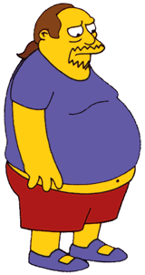
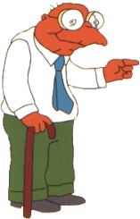

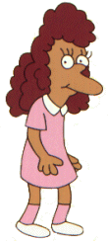
We need don’t need to keep the data around, just the test conditions.
Weight <= 160?
yes
no
How would these people be classified?
Hair Length <= 2?
Male
yes
no
Male
Female

Slide 31
It is trivial to convert Decision Trees to rules…
Weight <= 160?
yes
no
Hair Length <= 2?
Male
yes
no
Male
Female
Rules to Classify Males/Females
If Weight greater than 160, classify as Male
Elseif Hair Length less than or equal to 2, classify as Male
Else classify as Female

Slide 32
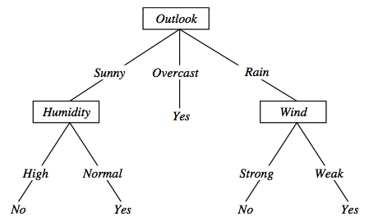
Decision trees expressivity
Decision trees represent a constraints on the value of attributes:
  (Outlook = Sunny ∧ Humidity = Normal) ∨
  (Outlook = Overcast) ∨
  (Outlook = Rain ∧ Wind = Weak)
Maria Simi

